Slide 1

Professors:
Vittorio Curri
Cecilia Clivati
Student:
Egle Antonucci s347960
Full title of the project
A.Y. 2025-26

Slide 2
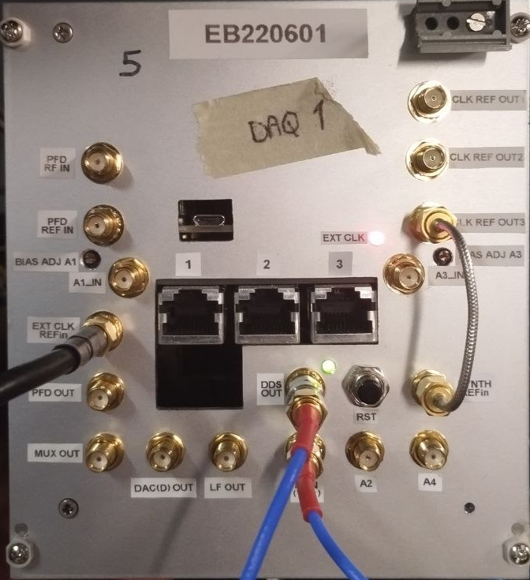
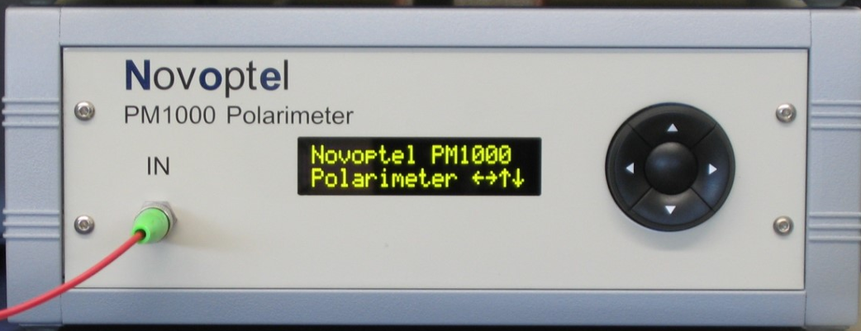
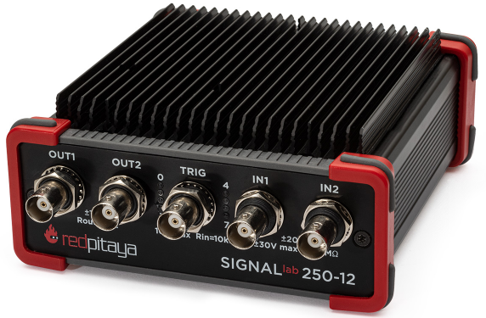
Obiettivo
Sviluppare un sistema di acquisizione integrato e validato per la misura simultanea di SOP e fase su fibra, in cui un polarimetro e un analizzatore di fase operano sincronizzati su un'unica base temporale, progettato per esperimenti di lunga durata in condizioni reali.
PM1000 Polarimeter Novoptel
RedPitaya SIGNALlab 250-12
STM32H745
Reference: Donadello et al. - 2023 - Embedded Digital Phase Noise Analyzer for Optical Frequency Metrology
2

Slide 3

Schema di timestamping
fase
Vpp^{min}= 1.5 V
Stokes
FPGA
PM1000
$$\sim$$
10 MHz
STM32
3

Slide 4
Acquisition modes
Configuration
Pros
Cons
Dynamic Undersampling
DYN_UNDERSAMPLE = 1
rearm = 1
rearm_dno =1
Continuous data stream.
High memory overhead: 50% of SDRAM used for timestamps.
Triggered recording mode
SYNC_EXT_RISE = 1
CYCLIC = 1
rearm = 1
rearm_dno = 1
Only one timestamp per recorded block.
Discontinuous stream;
Pre-trigger mechanism wastes memory.
SYNC_EXT_RISE = 0 rearm = 1
rearm_dno = 1
Continuous data stream.
No timestamps.
Manual recording mode
LIMITATION
Because the PM1000 lacks an internal real-time clock, all standard modes fail to provide the absolute timestamps required for phase data synchronization.
4

Slide 5


Modified Manual Recording
Configuration
SYNC_EXT_RISE = 1
rearm = 1
rearm_dno = 1
CYCLIC = 0
DYN_UNDERSAMPLING = 0
SYNC_EXT_FALL = 0
TRIG_NEXT_BNC = 0
PPS_SYNC_EXT = 0
PPS_EXT_INT = 0
…
pm.write(BASE+82,old_block_nr)
Long, continuous acquisition
Syncronization
Exactly one SOP sample recorded for every rising edge on BNC connector.
Timestamps
The exact time of the first SOP sample is known with high precision.
ATE
$$f_{s}=\frac{100 MHz}{2^{ATE}}$$
$$f_{s}=BNC_FREQ$$
ATE is still applied purely to average samples and improve SNR.
5

Slide 6
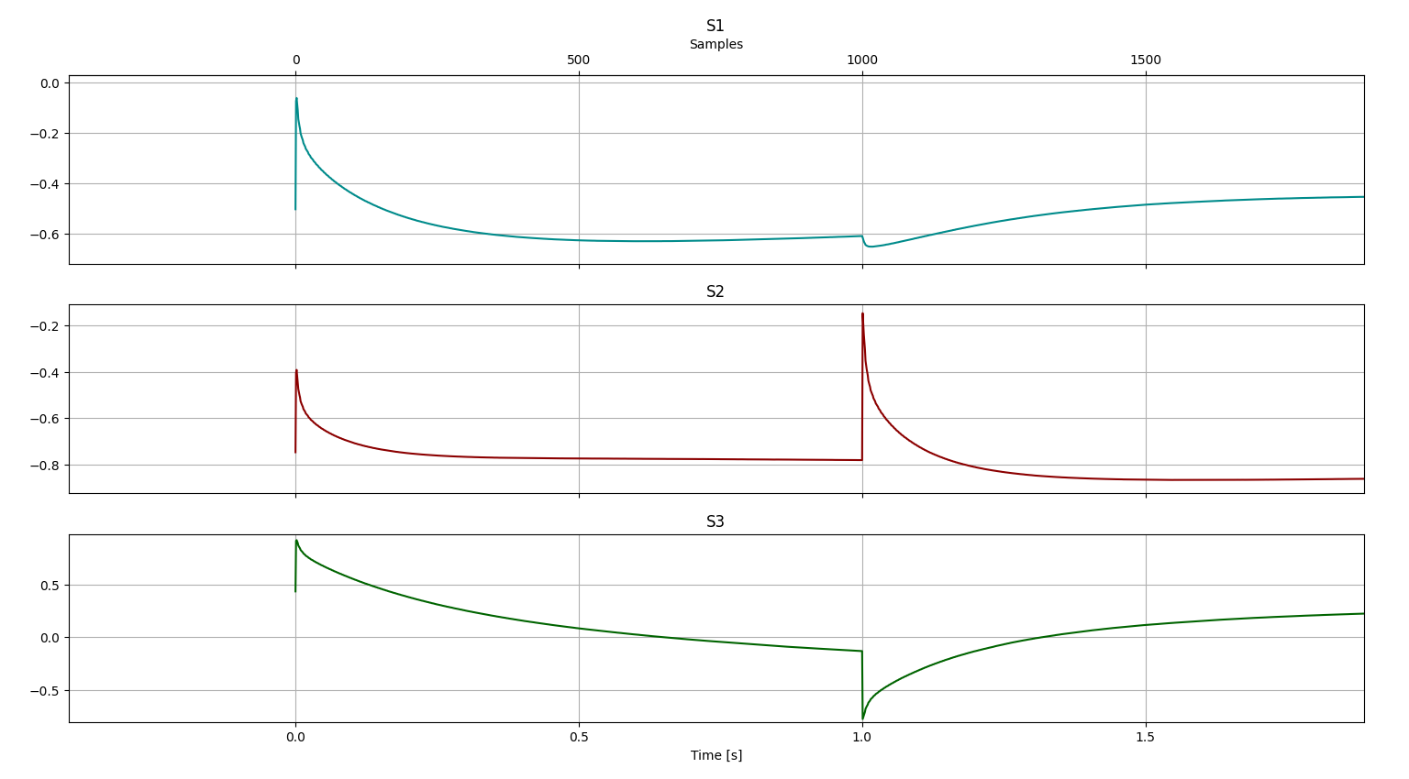
Allineamento al fronte di salita
7

Slide 7
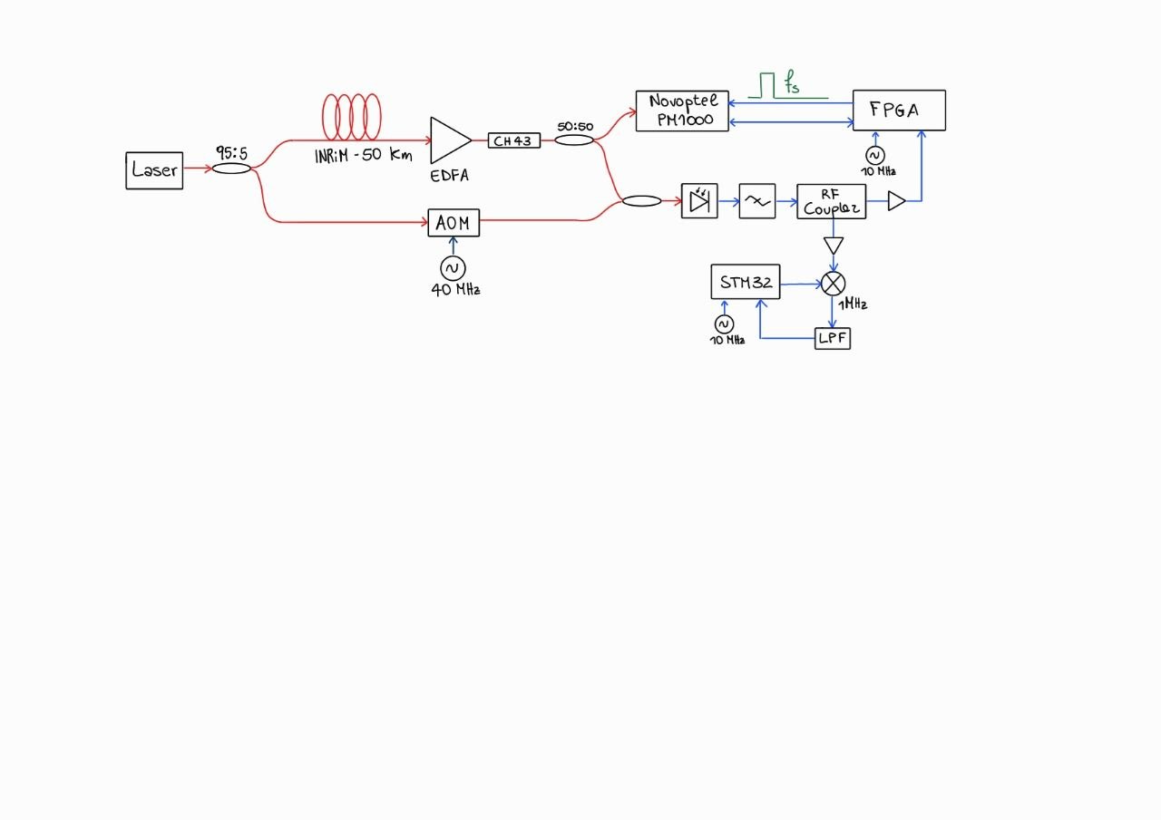
Schema circuito
6

Slide 8
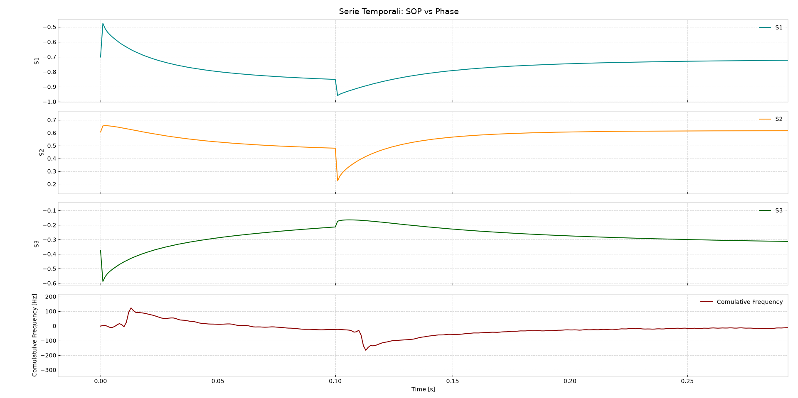
Sincronizzazione FPGA-PM1000: segnale ideale
8

Slide 9
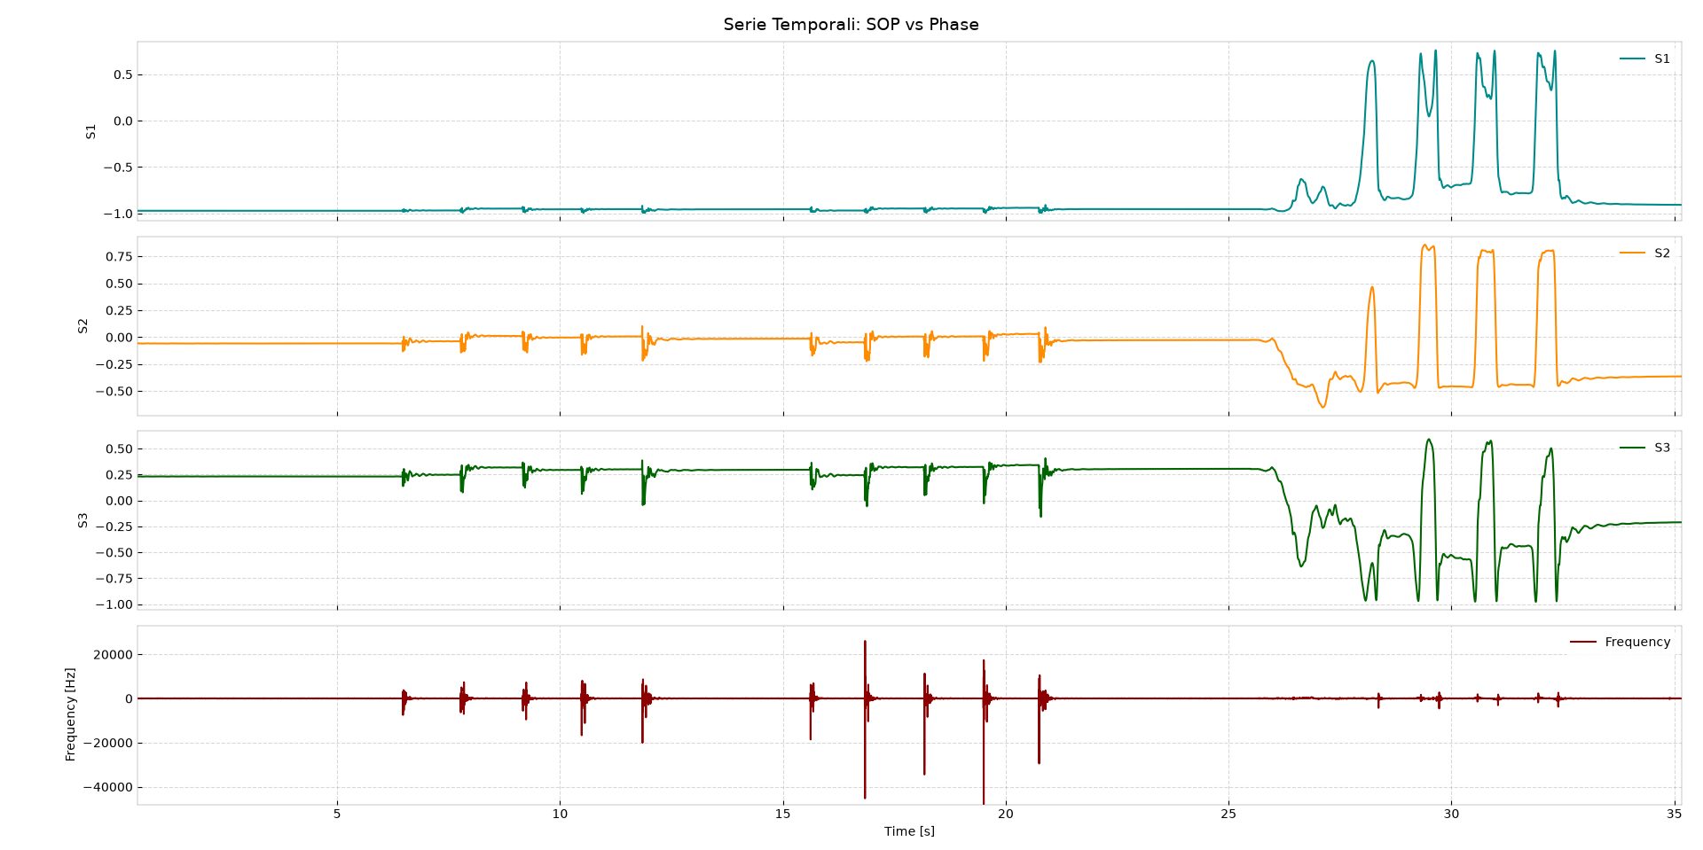
Sincronizzazione FPGA-PM1000: segnale reale
9

Slide 10
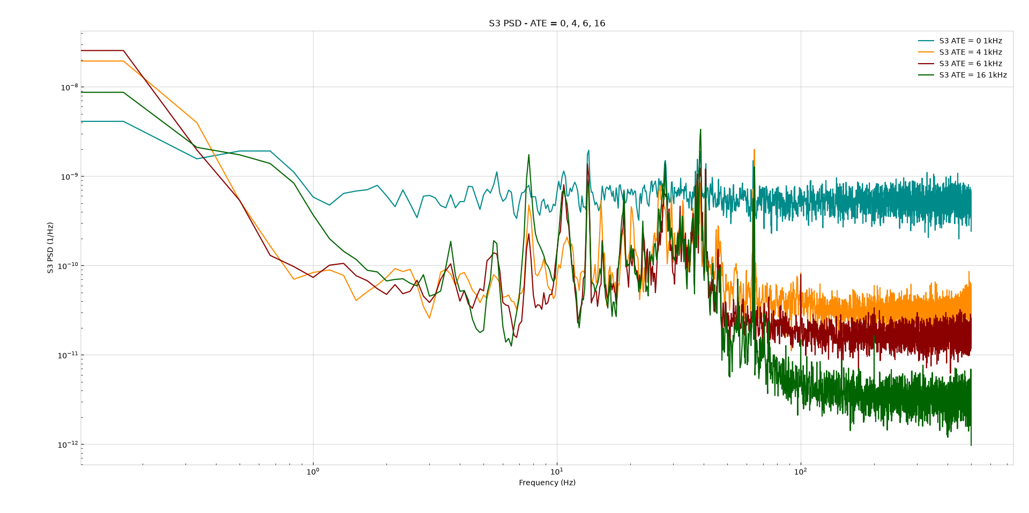
PSD SOP diversi valori di ATE
Credo di essere nella black list di Ben ☹
10

Slide 11
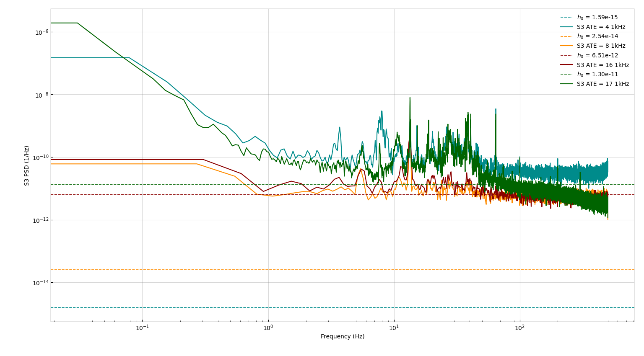
12

Slide 12
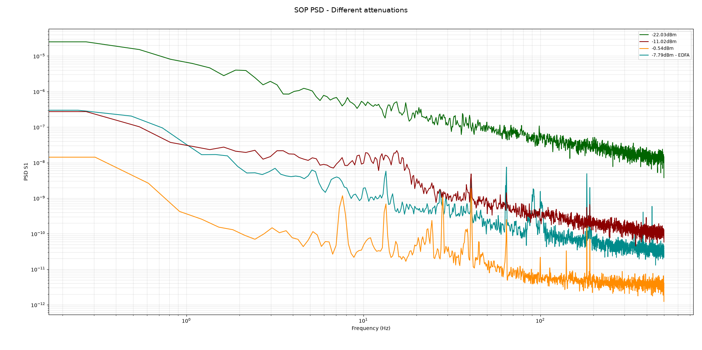
PSD SOP con diversi livelli di Pin
12

Slide 13

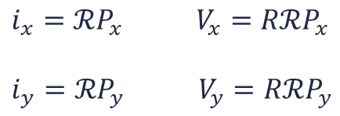

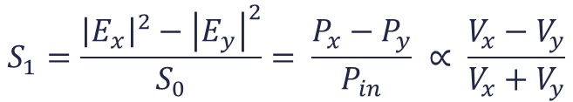





Errore ADC
$i_{x}=ℛP_{x}$ $V_{x}=RℛP_{x}$
$i_{y}=ℛP_{y}$ $V_{y}=RℛP_{y}$
$$S_{1}=\frac{{\left|E_{x}\right|}^{2}−{\left|E_{y}\right|}^{2}}{S_{0}}= \frac{P_{x}−P_{y}}{P_{in}} ∝ \frac{V_{x}−V_{y}}{V_{x}+V_{y}}$$
$$⇒$$
$$⇒$$
$$⇒$$
$S_{1}^{′}=\frac{\left(V_{x}+n_{x}\right)−\left(V_{y}+n_{y}\right)}{V_{x}+V_{y}}$ = $\frac{\left(V_{x}−V_{y}\right)}{V_{x}+V_{y}}+\frac{\left(n_{x}−n_{y}\right)}{V_{x}+V_{y}}=S_{1}+\frac{\left(n_{x}−n_{y}\right)}{V_{x}+V_{y}}$
$$⇒$$
${PSD}_{S_{1}^{′}}={PSD}_{S_{1}}+{PSD}_{{ADC}_{x}}$ $+{PSD}_{{ADC}_{y}}$
$${PSD}_{{ADC}_{x}}=\frac{n_{x}}{{\left(V_{x}+V_{y}\right)}^{2}}∝\frac{1}{P_{in}^{2}}$$
$$⇒$$
$${PSD}_{{ADC}_{y}}=\frac{n_{y}}{{\left(V_{x}+V_{y}\right)}^{2}}∝\frac{1}{P_{in}^{2}}$$
13

Slide 14
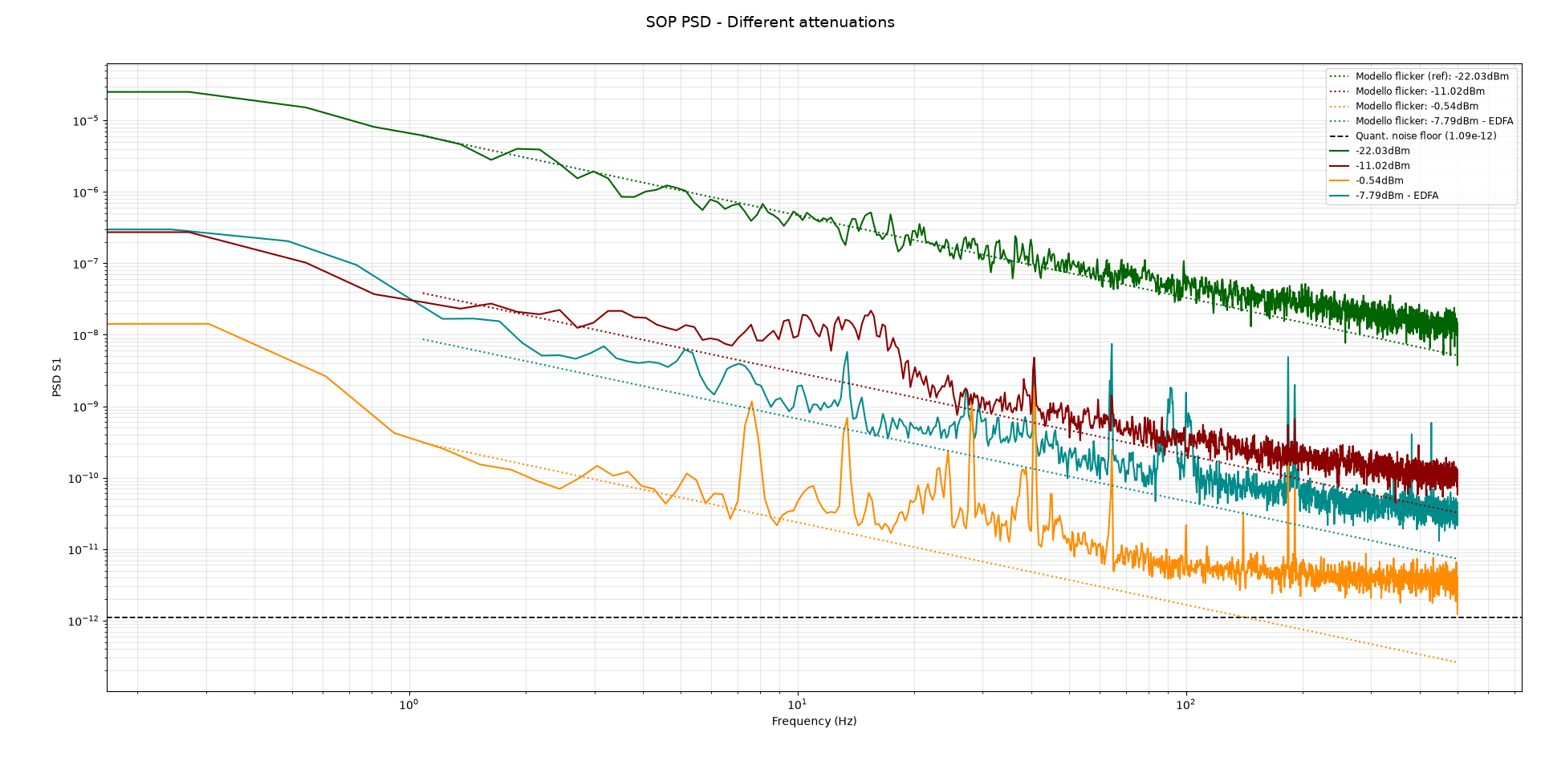
PSD SOP con diversi livelli di Pin
14

Slide 15
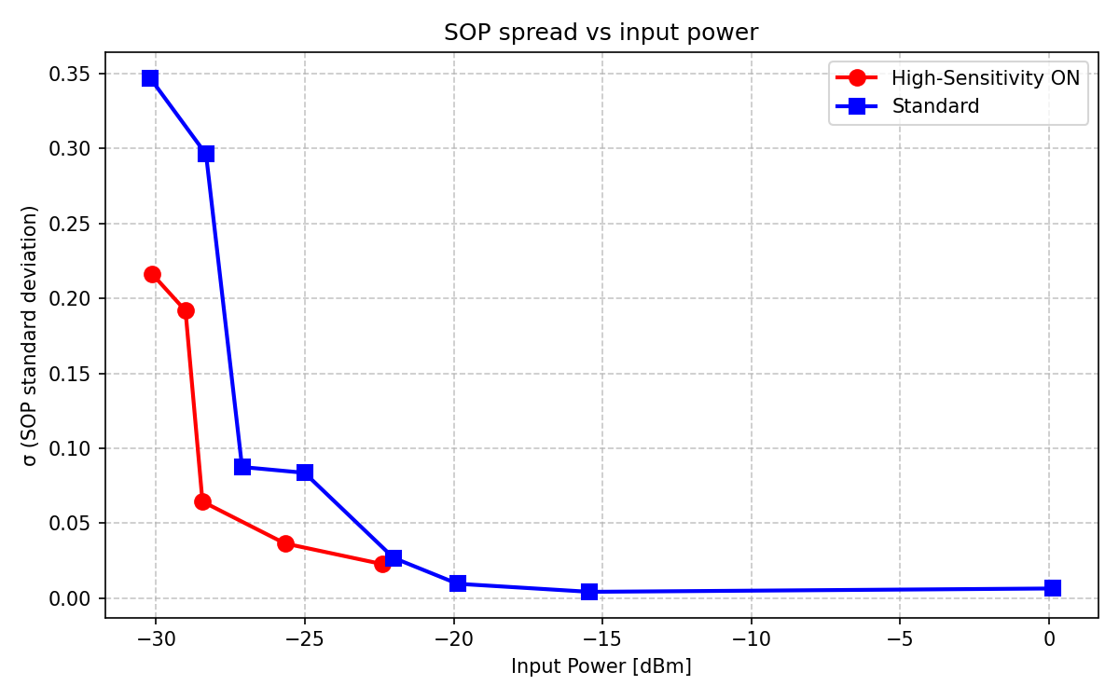
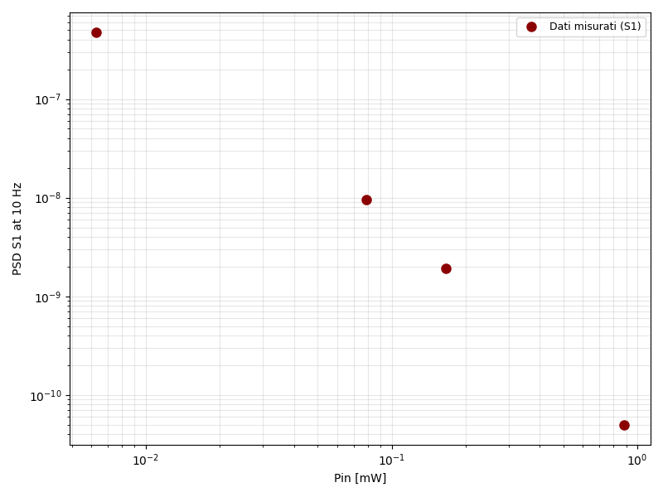
Caratterizzazione del rumore in funzione di Pin
14

Slide 16
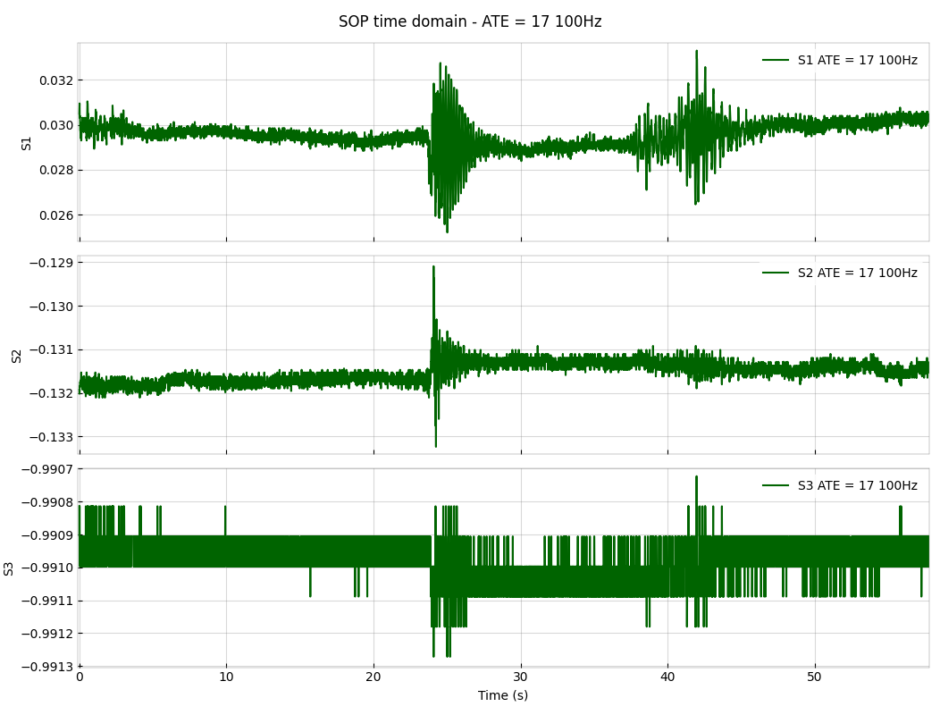

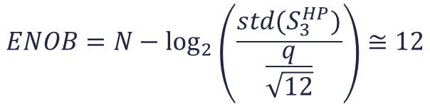
Quantizzazione
$$q_{teorico}=2^{−15}≅3.05∙{10}^{−5}$$
$$ENOB=N−\log_{2}\left(\frac{std(S_{3}^{HP})}{\frac{q}{\sqrt{12}}}\right)≅12$$
$$q_{eff}≅2^{−12}≅0.0002$$
15

Slide 17
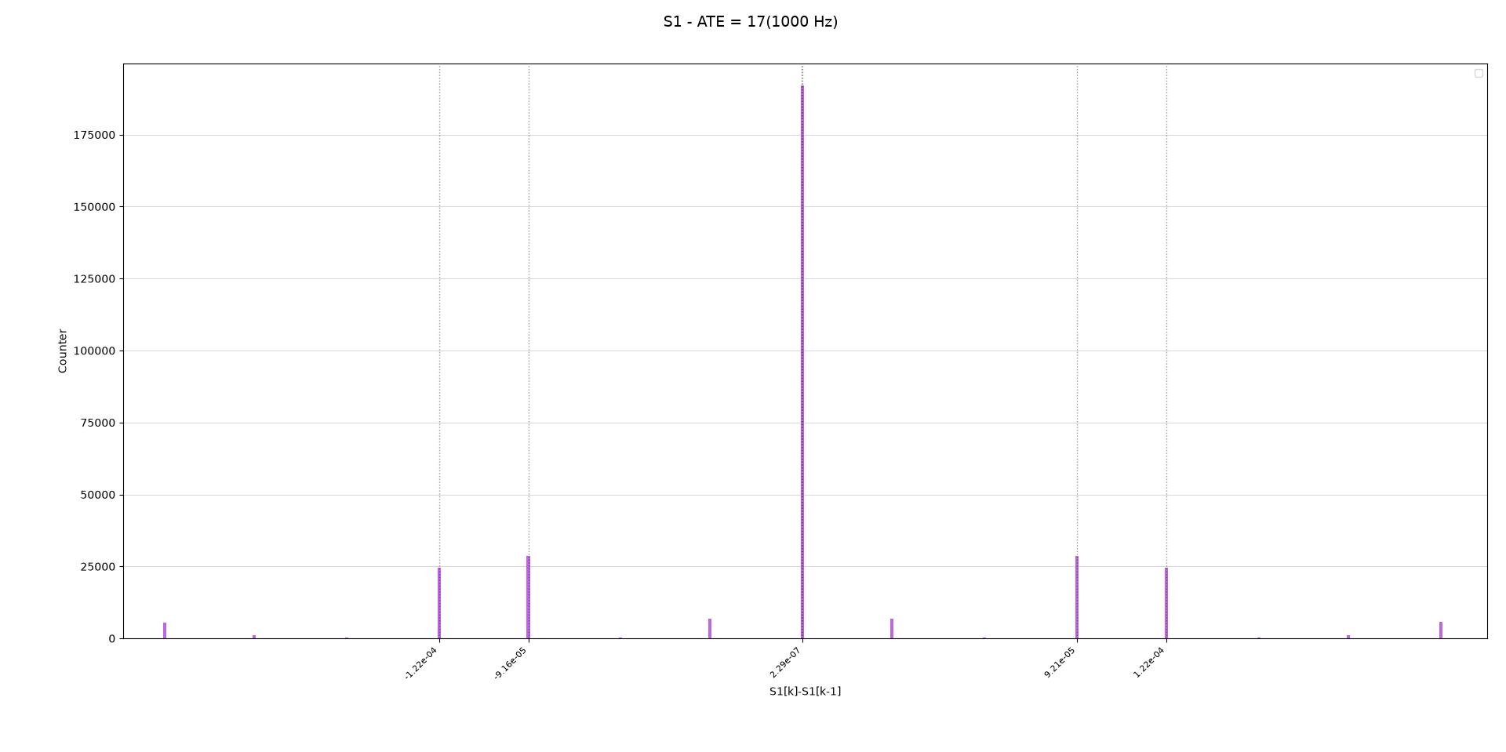
Istogramma diff(S1)

Slide 18
Si accettano consigli

Slide 19
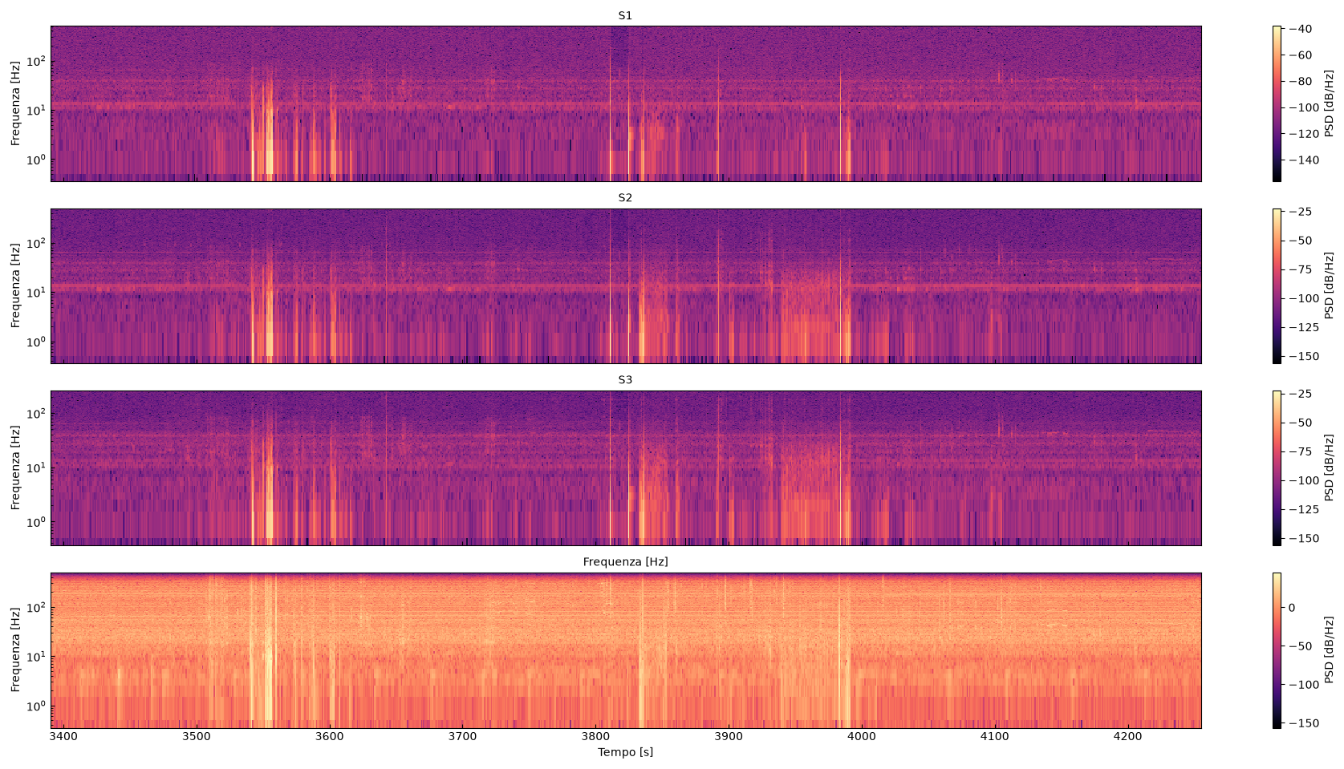
Sensing EdificioA - INRiM
17

Slide 20
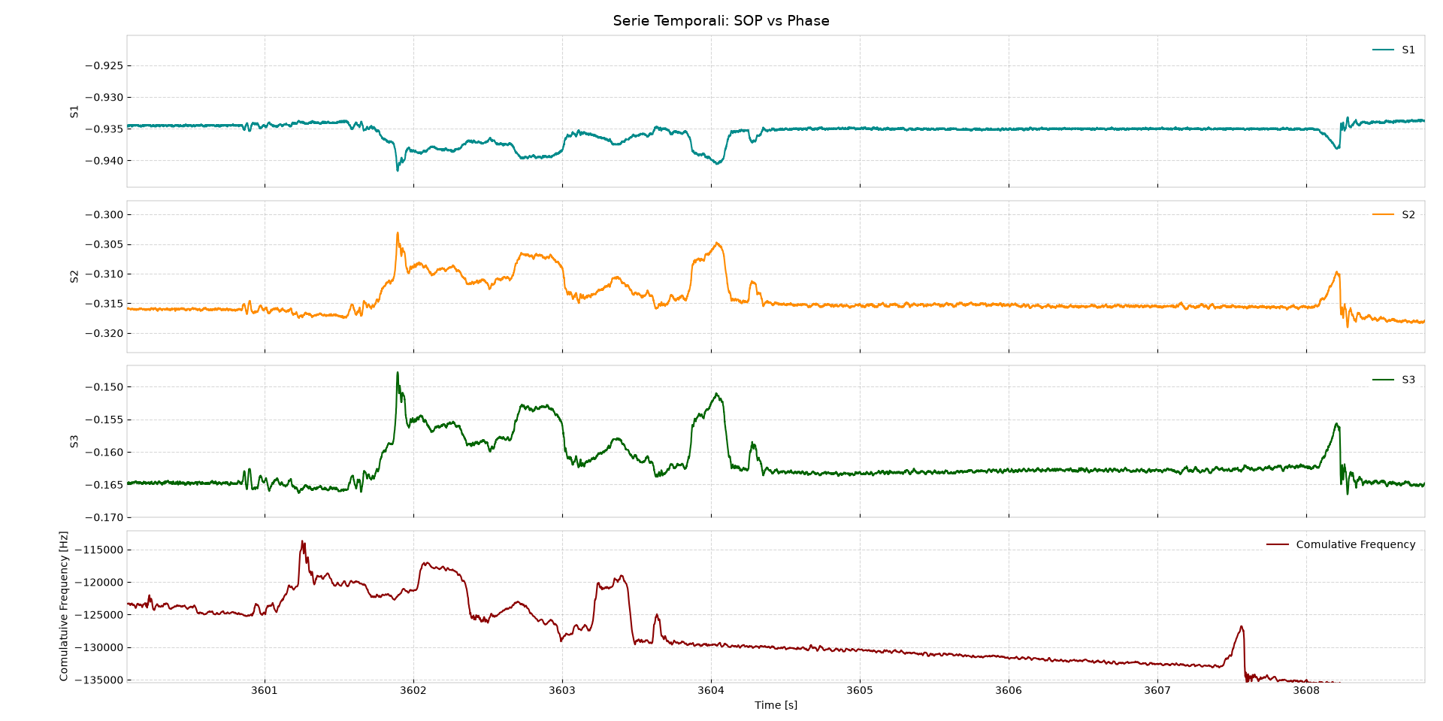
Sensing Edificio
18

Slide 21
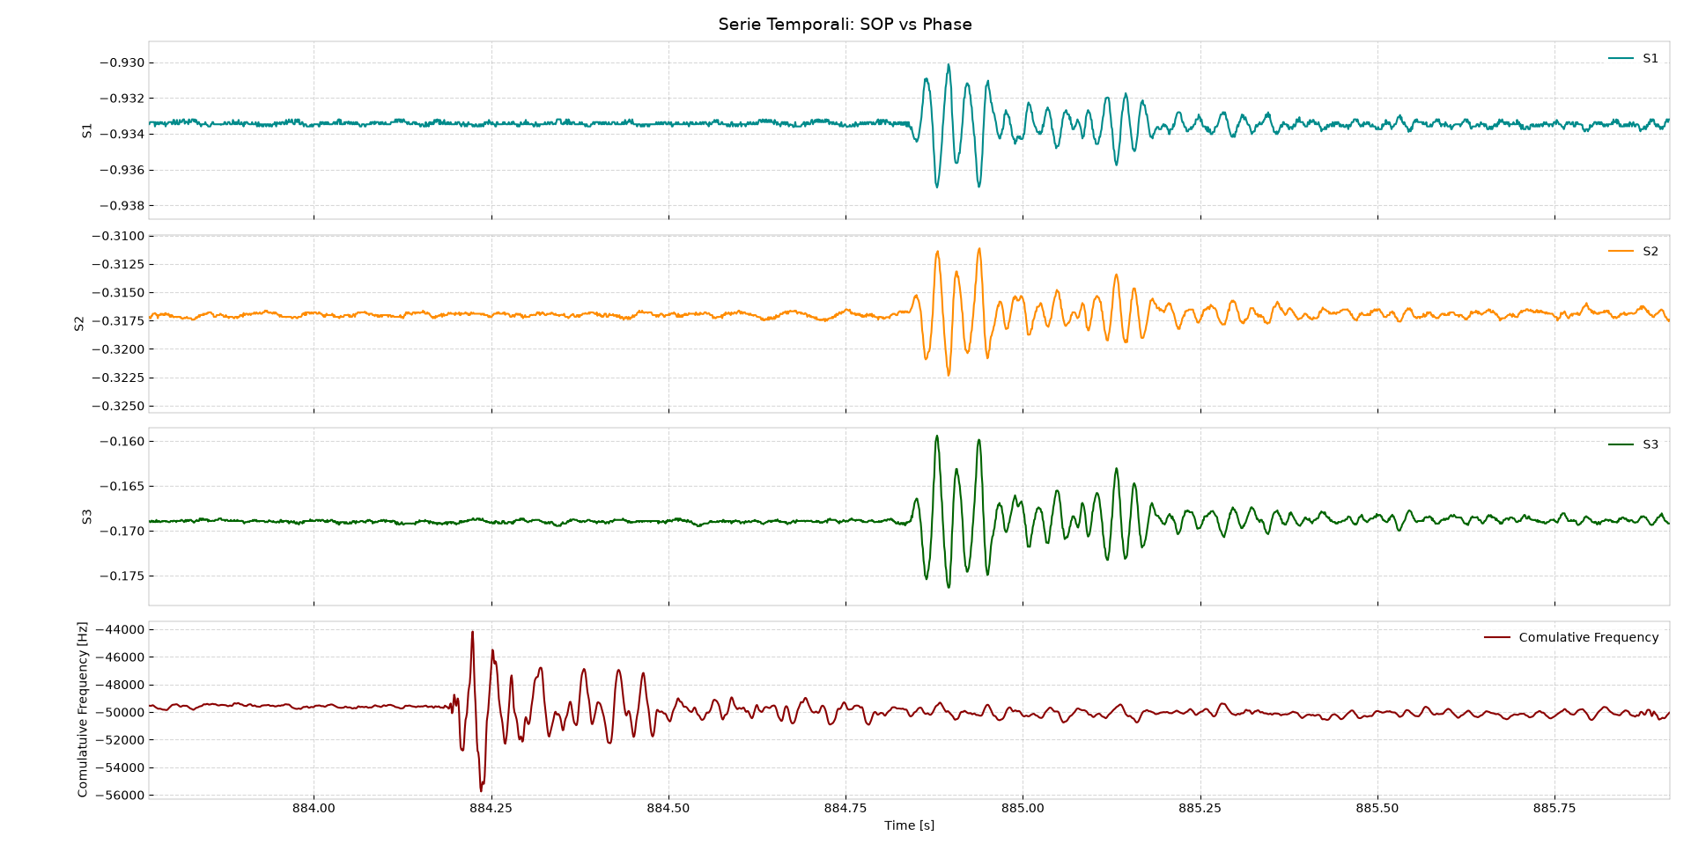
Sensing Edificio
19

Slide 22
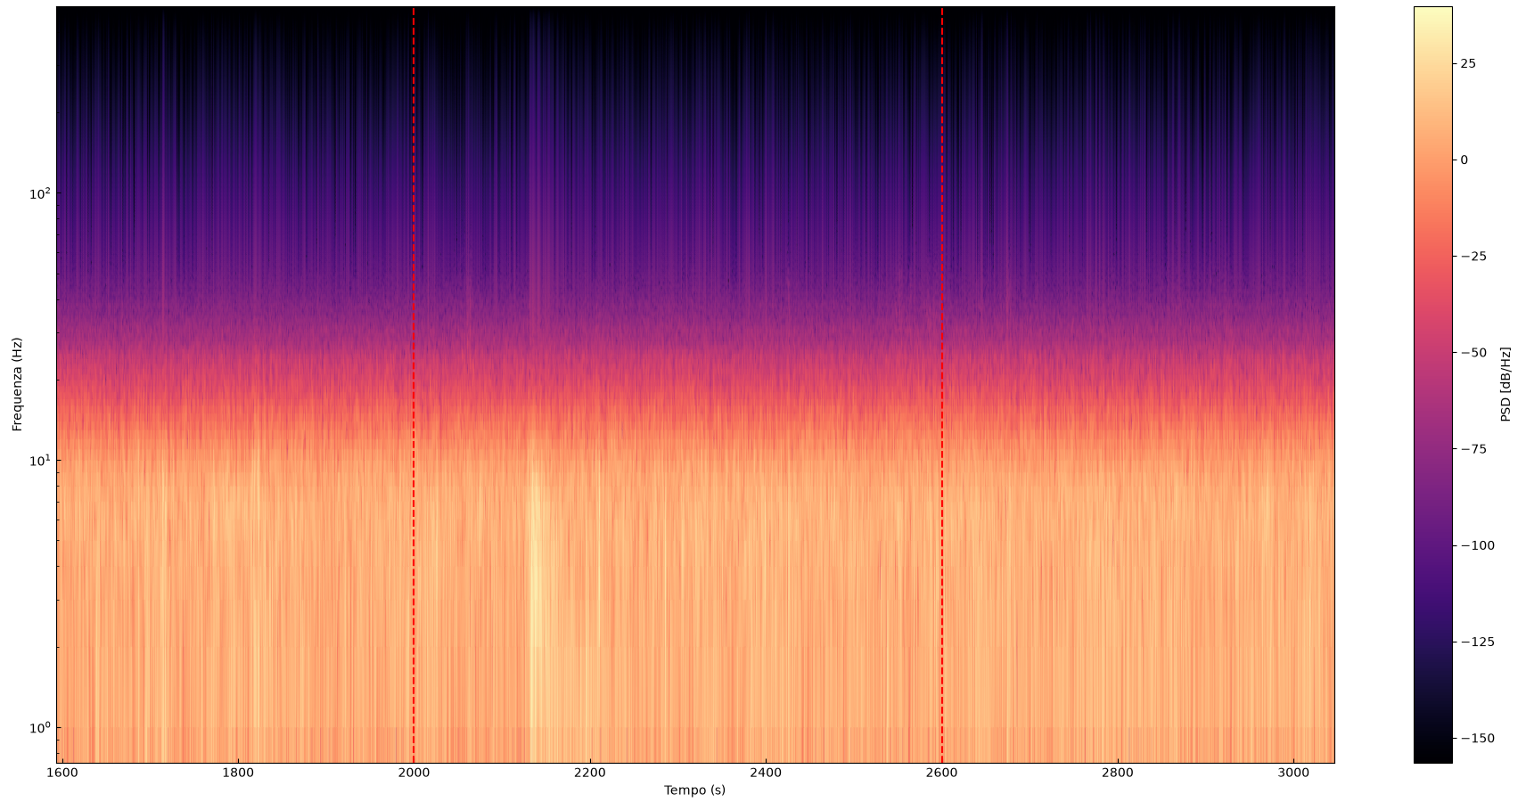
Terremoto
5 km N San Damiano Macra (CN), Mw 3.3, 09/08/2026 00:10:34 (UTC+02:00)
19

Slide 23
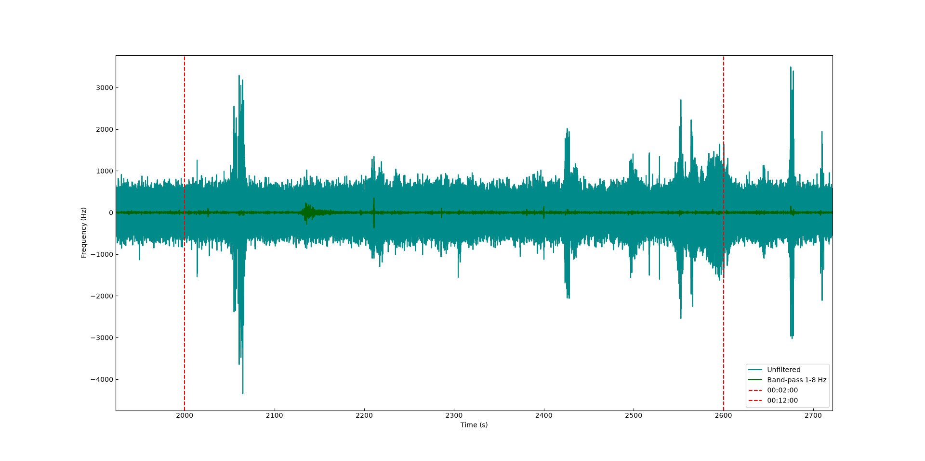
Terremoto
5 km N San Damiano Macra (CN), Mw 3.3, 09/08/2026 00:10:34 (UTC+02:00)
20

Slide 24
THANKS FOR YOUR ATTENTION

